Slide 1
Tracking of Simulated Biomass Particles in Bubbling Fluidized Beds
Stuart Daw, Jack Halow, Sreekanth Pannala, Gavin Wiggins, and Emilio Ramirez
2013 AICHE National Meeting
52: Fluidization and Fluid-Particle Systems for Energy and Environmental Applications I
San Francisco, November 4, 2013
This presentation does not contain any proprietary, confidential, or otherwise restricted information

Slide 2
Outline
Objectives
Background and Motivation
Experimental Setup and Example Observations
Modeling Approach and Preliminary Results
Summary and Status

Slide 3
Objectives
Utilize magnetic particle tracking to measure dynamic behavior of simulated biomass particles in bubbling fluidized beds
Develop a simple model that mimics observed particle behavior and apply it to simulate bubbling bed pyrolysis

Slide 4
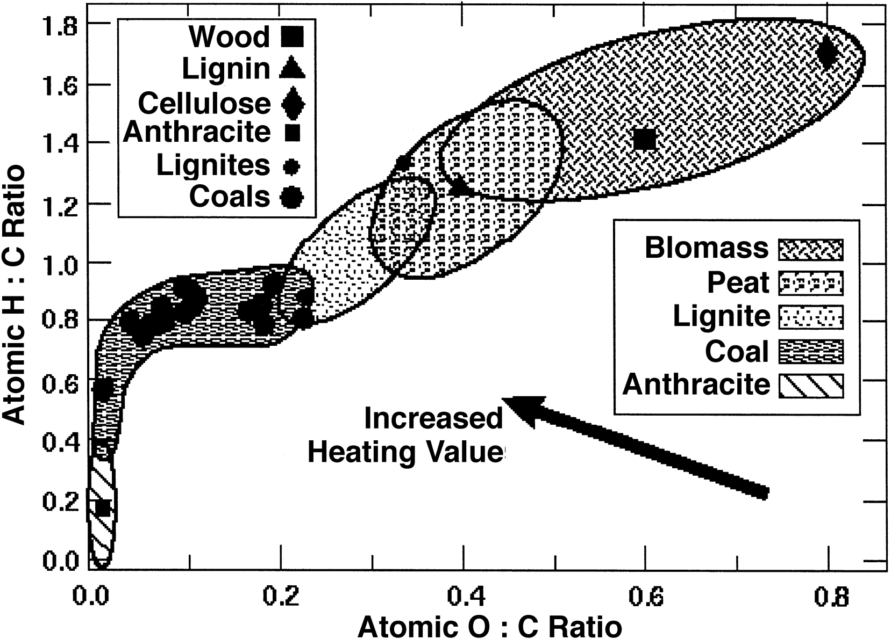
Background: Biomass conversion to liquid fuels
Biomass
Coal
Anthracite
Source: B.M. Jenkins, et al., Fuel Processing Technology, 54 (1998), 17-46

Slide 5
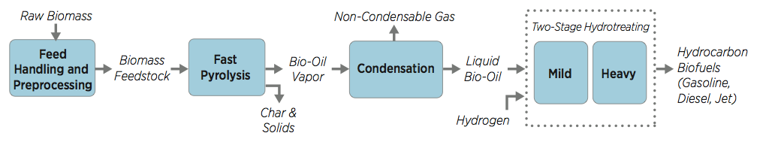
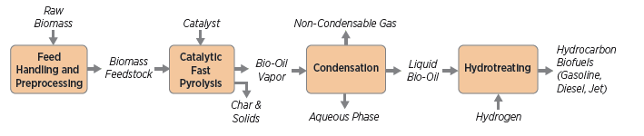
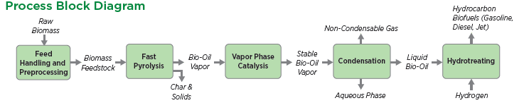
Background: Fast pyrolysis is a critical step in 3 biomass-to fuel processes
Fast pyrolysis and hydroprocessing
In-situ catalytic fast pyrolysis
Ex-situ catalytic fast pyrolysis

Slide 6
Background: One widely used approach for fast pyrolysis utilizes bubbling beds
Group B bed solids (e.g., sand) with or without catalyst
Bed fluidized under no-oxygen conditions (mostly N₂, CO₂, H₂O)
Raw biomass injected as particles and removed as char
Biomass typically <1% of bed mass
Bed temperature 400-600°C
Very rapid heat up (up to 1000°C/s)
Mixing and particle RTD very important to product composition and conversion
Biomass
Cyclone
Drying
Grinding
Bubbling
Fluidized
Bed
Reactor
Quench
Cooler
Char
Bio-Oil to Upgrading
Fluidizing
Gas
Non-condensable gas

Slide 7
Motivation: Accurate pyrolysis reactor modeling is needed to assess options
Complex heat, mass, and momentum transport
  Within biomass particles
  Between biomass and bed particles
  Particle mixing and residence time in bed
  Released pyrolysis products (char, tar, light gases)
Complex chemistry
  Intra-particle (decomposition, cracking, polymerization)
  Catalysis of released gases
Variable feedstock properties and conditions
  Chemical composition (C, H, O, moisture)
  Particle size and shape
  Fluidization state, reactor size, temperature, pressure

Slide 8
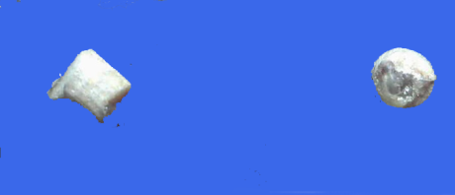
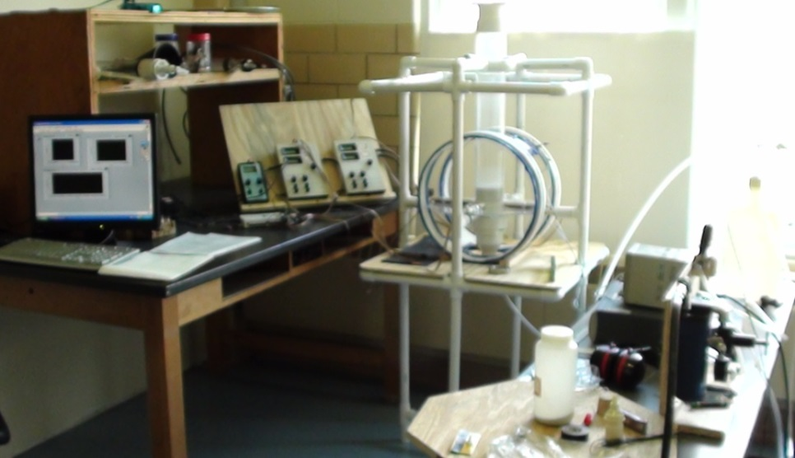

Experimental Approach: Magnetic particle tracking to simulate biomass mixing*
Simulated biomass (tracer) particles are constructed by inserting tiny neodymium magnets into balsa wood cylinders (typically >1 mm diameter, 0.4-1 g/cc)
Bed particles (e.g., 207 micron glass, 2.5 g/cc) are fluidized with ambient air (1.0 <= U/Umf <=5.0)
Side
Top
Single tracer particles are injected in bed at specific fluidization conditions and tracked
Special algorithms de-convolute signals to give 3D particle trajectory
Experimental facility at Separation Design Group Lab
* See IECR 2010, 49, 5037–5043 and 2012, 51, 14566–14576

Slide 9
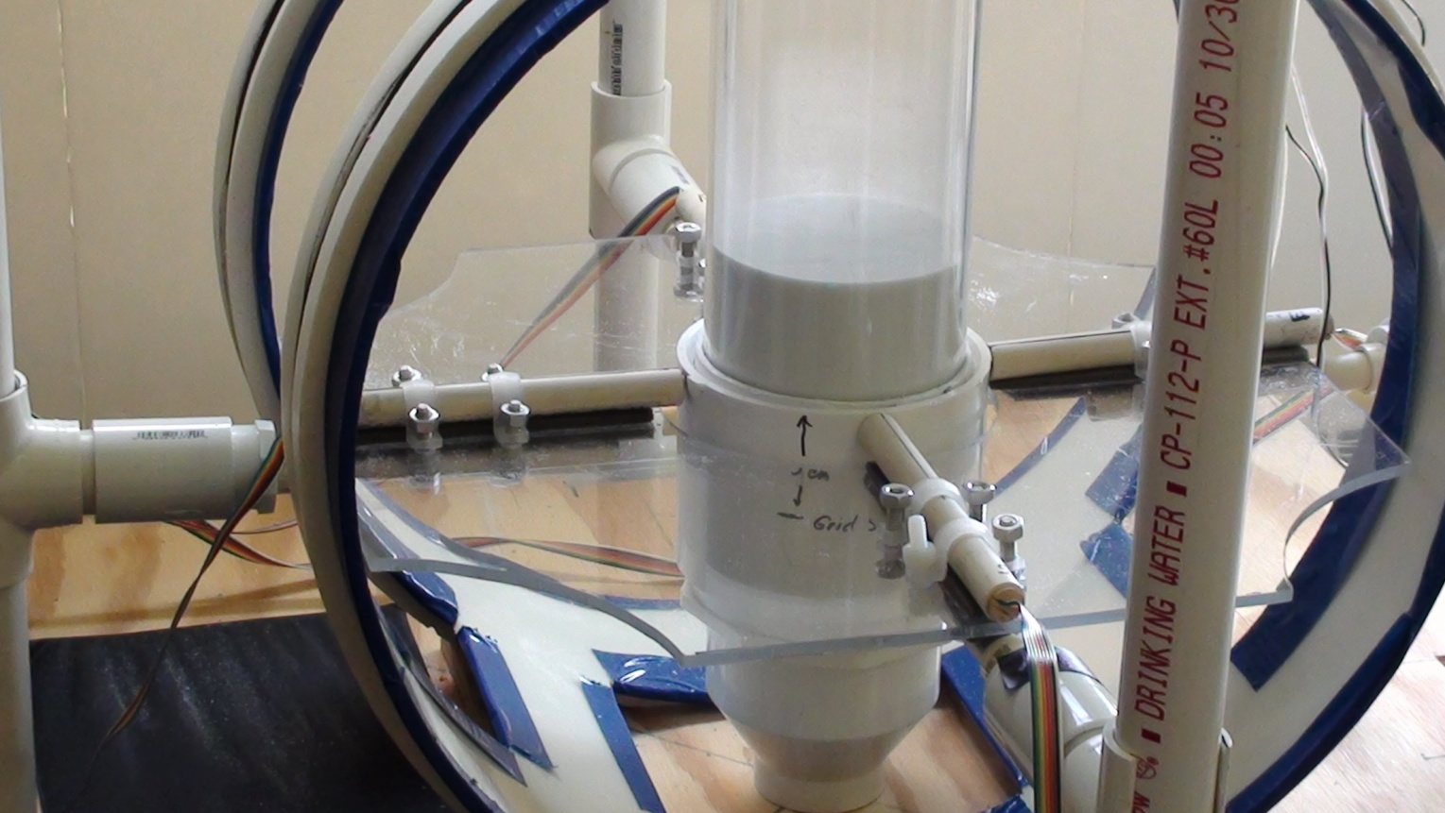

Experimental Approach: 5.5 cm bed
Probes aligned North, South, East, West
Helmholtz coils modify earth’s magnetic field in bed
Non-metallic bed and supports
100 Hz sampling rate
5 min runs (30,000 points)
Porous plate distributor

Slide 10
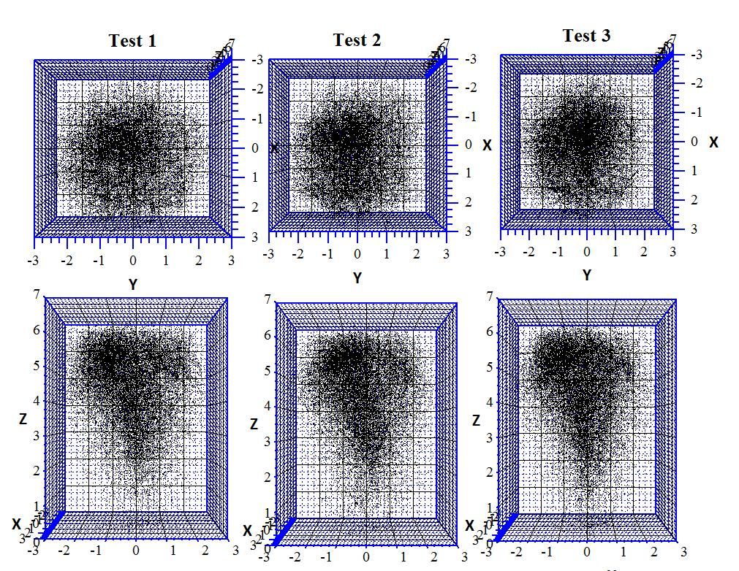
Experimental Results: Trajectories map 3D time-average mixing
Top View
Side View

Slide 11
Experimental Results: Vertical mixing profiles follow Weibull statistics
1
4.5 x 4.5 cm cylindrical particle, .76 g/cc, U/Umf=3.0
1
0.9
0.9
0.8
Data
0.8
0.7
Fit
0.7
0.6
0.6
Cumulative Probability
0.5
0.5
0.4
0.4
0.3
0.3
0.2
0.2
0.1
0.1
0
0
0
2
4
6
8
10
12
0
2
4
6
8
10
12
14
Axial Position (cm)

Slide 12
Experimental Results: Time series data reveal dynamics of particle motion
12
10
8
Axial Position (cm)
← Vertical bias
6
4
2
0
0
50
100
150
200
250
300
Time (s)
3
2
1
Horizontal Position (cm)
←No horizontal bias
0
-1
-2
-3
0
50
100
150
200
250
300
Time (s)

Slide 13
Modeling Approach: Low-order dynamic biomass pyrolysis reactor model
Develop dynamic particle model that yields correct mixing statistics (multiple particles and different particle histories)
Account for changes in biomass particle properties as pyrolysis occurs (translate tracking data to dynamic context)
Key assumptions:
  Initial focus on steady state
  Released pyrolysis gases do not alter the fluidization state
  Bed temperature is uniform
  Biomass is represented by a single equivalent particle size
  Each biomass particle follows a similar heat-up and devolatilization trajectory (from separate model)

Slide 14
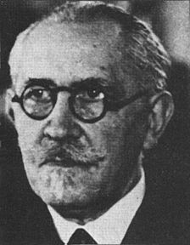
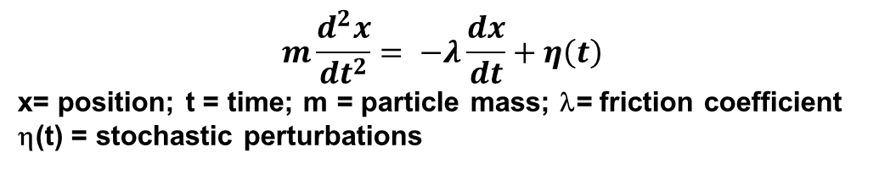
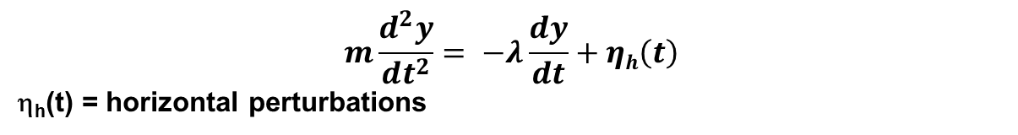
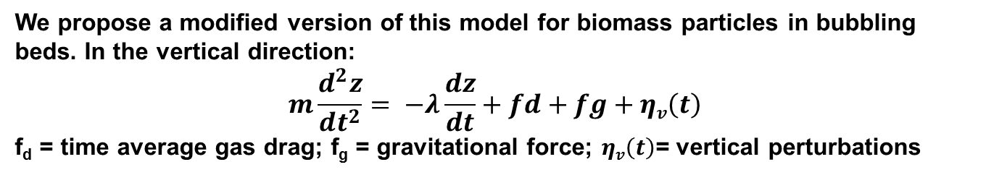
Modeling Approach: Langevin model
$$m\frac{d^{2}x}{dt^{2}}= −λ\frac{dx}{dt}+η\left(t\right)$$
x= position; t = time; m = particle mass; λ= friction coefficient
η(t) = stochastic perturbations
Originally proposed by Paul Langevin (C. R. Acad. Sci. (Paris) 146: 530–533, 1908) to describe Brownian motion
Paul Langevin (1872-1946)
We propose a modified version of this model for biomass particles in bubbling beds. In the vertical direction:
$$m\frac{d^{2}z}{dt^{2}}= −λ\frac{dz}{dt}+fd+fg+ηv\left(t\right)$$
f_{d} = time average gas drag; f_{g} = gravitational force; $ηv\left(t\right)$= vertical perturbations
A similar force balance can be written for horizontal particle position except that we assume no time-average drag or gravitational forces:
$$m\frac{d^{2}y}{dt^{2}}= −λ\frac{dy}{dt}+ηh\left(t\right)$$
η_{h}(t) = horizontal perturbations

Slide 15
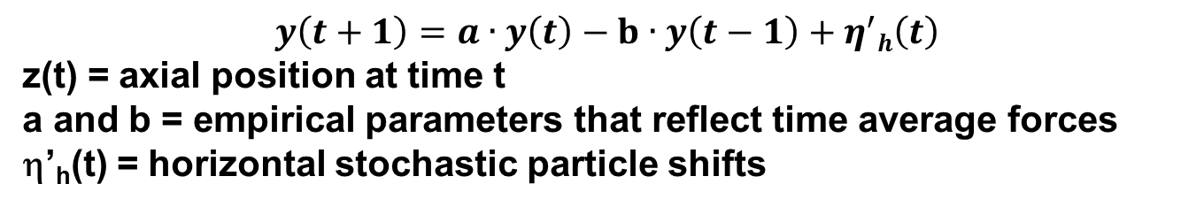
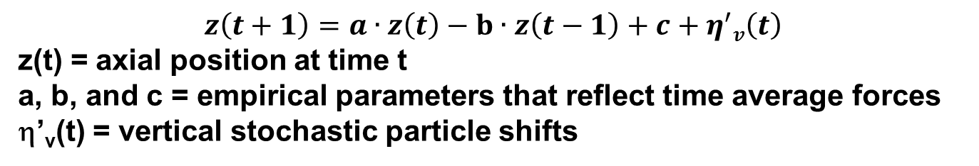
Modeling Approach: A discrete Langevin approximation
Approximating derivatives over discrete time intervals and combining and rearranging terms for vertical motion results in:
$$z\left(t+1\right)=a∙z\left(t\right)−b∙z\left(t−1\right)+c+η^{′}v\left(t\right)$$
z(t) = axial position at time t
a, b, and c = empirical parameters that reflect time average forces
η’_{v}(t) = vertical stochastic particle shifts
a, b, and c can be estimated with experimental particle position time series
Stochastic inputs, η’(t), can be estimated from stepwise prediction errors
For horizontal motion, the result is:
$$y\left(t+1\right)=a∙y\left(t\right)−b∙y\left(t−1\right)+η^{′}h\left(t\right)$$
z(t) = axial position at time t
a and b = empirical parameters that reflect time average forces
η’_{h}(t) = horizontal stochastic particle shifts

Slide 16

Modeling Results: 2nd-order regression is sufficient for magnetic particle motion
$$x\left(t+1\right)=\sum_{i=1}^{n}{A(i)}∙x\left(t+1−i\right)+c+η^{′}\left(t\right)$$
Evaluate change in error (prediction) with increasing order
Stop increasing order when error converges
-3
Simulated biomass particle 4.5 mm cylinder, .76 g/cc, U/Umf=3.0, Δt=.01 s
3
x 10
2.5
Normalized error
2
1.5
1
1
2
3
4
5
Regression order (n)

Slide 17
Preliminary Results: Parameter values follow simple trends
4.5 mm x 4.5 mm cylindrical biomass particle, .76g/cc
5.5 mm spherical biomass particle, .41g/cc
2
2
1.5
1.5
a
1
a
1
b
b
c
c
0.5
0.5
Estimated Parameter Value
Estimated Parameter Value
0
0
-0.5
-0.5
-1
-1
1
1.5
2
2.5
3
3.5
4
4.5
5
1.5
2
2.5
3
3.5
4
4.5
5
U/Umf
U/Umf
4.5 mm x 4.5 mm cylindrical simulated biomass particle, .76 g/cc
0.09
5.5mm spherical simulated biomass particle, .41 g/cc
0.1
0.09
0.08
0.08
0.07
0.07
0.06
0.06
Amplitude of stochastic term
Amplitude of stochastic term
0.05
0.05
0.04
0.04
0.03
0.02
0.03
0.01
0.02
1
1.5
2
2.5
3
3.5
4
4.5
5
1.5
2
2.5
3
U/Umf
3.5
4
4.5
5
U/Umf

Slide 18
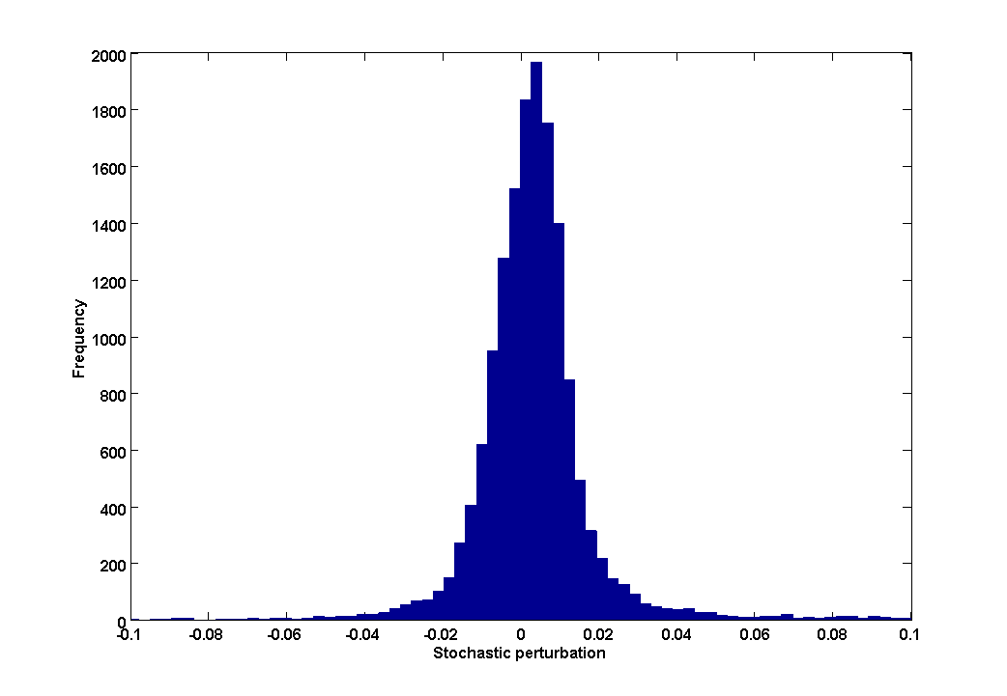
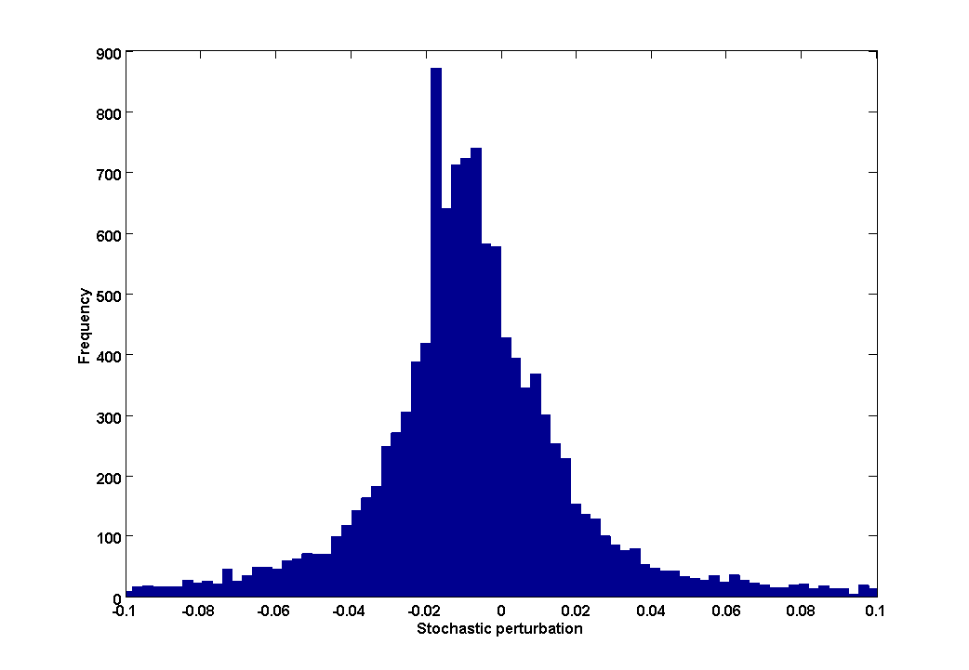
Preliminary Results: Stochastic effects vary spatially over the bed
Vertical stochastic fluctuations in upper bed
Stochastic fluctuations in lower part of bed
Need to understand more details about these variations
CFD may be a useful tool

Slide 19
Preliminary Results: Simplified model can closely approximate particle statistics
1
4.5 x 4.5 mm cylindrical biomass particle, .76 g/cc, U/Umf=3.0
0.9
0.8
Model
0.7
Data
0.6
Cumulative Probability
0.5
0.4
0.3
0.2
0.1
0
0
2
4
6
8
10
12
Axial Position (cm)
Observed particle statistics are closely approximated by the model already, but simulation of spatial variations in stochastic fluctuations can be improved

Slide 20
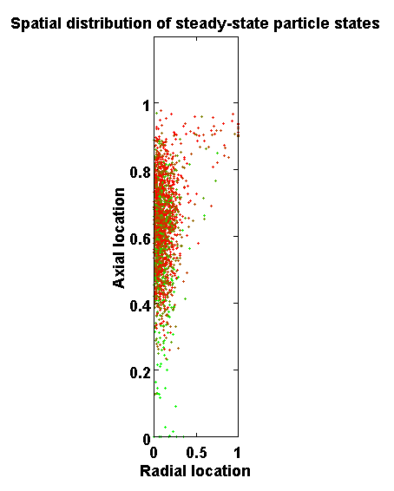
Preliminary Results: Particle distribution in integral reactor
Track 100s-1000s of particles in steady-state reactor
  Specify biomass injection location and steady-state bed inventory
  Specify condition for char particles to exit the bed (e.g., location, density)
  Inject new particle each time one exits (maintain steady state)
  Increment position of each particle by Langevin rules
  Particles devolatilize according to heat up and reaction models
Green- Raw (high VM)
Red- Devolatilized (low VM)

Slide 21
Preliminary Results: Integral model yields ss pyrolysis rates, conversions

Slide 22
Preliminary Results: Integral model yields ss pyrolysis rates, conversions

Slide 23
Summary and Status
Magnetic particle tracking yields unprecedented details about single particle motion in bubbling beds
A discrete Langevin model replicates the observed particle mixing statistics and time correlations
Langevin parameters can be correlated with changes in particle properties and fluidization state
Monte Carlo reactor simulations yield spatio-temporal distributions of ss particle residence time, age, and state of devolatilization
The above can predict pyrolysis performance trends with changes in feed properties and reactor conditions
Additional studies are underway to understand/improve the stochastic Langevin terms (CFD/DEM opportunities)

Slide 24
Acknowledgements
Melissa Klembara: U.S. Department of Energy, Bioenergy Technologies Office
Tim Theiss, Charles Finney : Oak Ridge National Lab
Separation Design Group, Waynesburg, PA
Computational Pyrolysis Project Partners
  Mark Nimlos, David Robichaud: National Renewable Energy Lab
  Robert Weber: Pacific Northwest National Lab
  Larry Curtiss: Argonne National Lab
  Tyler Westover: Idaho National Lab

